Slide 1
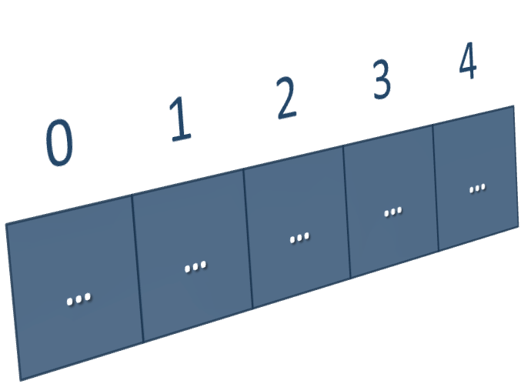
Lists
Processing Variable-Length Sequences of Elements
SoftUni Team
Technical Trainers
Software University
https://softuni.bg
Notes:
© SoftUni – https://softuni.org. Copyrighted document. Unauthorized copy or reproduction is not permitted.

Slide 2
Table of Contents
Lists
Reading Lists from the Console
Sorting Lists and Arrays
Notes:
© SoftUni – https://softuni.org. Copyrighted document. Unauthorized copy or reproduction is not permitted.

Slide 3
Have a Question?
sli.do
#csharp-fund
Notes:
© SoftUni – https://softuni.org. Copyrighted document. Unauthorized copy or reproduction is not permitted.

Slide 4
Lists
0
1
2
3
4
…
…
…
…
…

Slide 5
List<T> – Overview
List<T> holds a list of elements of the same type
List<string> names = new List<string>();
//Create a list of strings
names.Add("Peter");
names.Add("Maria");
names.Add("George");
//Add elements
foreach (var name in names)
Console.WriteLine(name);
Console.WriteLine(string.Join(", ", names));
//Print elements
Notes:
© SoftUni – https://softuni.org. Copyrighted document. Unauthorized copy or reproduction is not permitted.

Slide 6
List<T> – Basic Methods
Provides operations to add / insert / remove / find elements:
  Add(element) – adds an element to the List<T>
  Count – number of elements in the List<T>
  Remove(element) – removes an element (returns true / false)

Slide 7
List<T> – Basic Methods
  Insert(index, element) – inserts an element to a given index
  Contains(element) – determines whether an element is in the list
  Sort() – sorts the array/list in ascending order

Slide 8
Add() – Appends an Element
We create an empty List and start adding
elements
The Count increases each time we add
an element
10
20
30
0
  Count:
2
1
  List<int>
3

Slide 9
Remove() – Deletes an Element
We remove an element from the List
The Count decreases each time we remove
an element
2
  List<int>
  Count:
3
10
20
30

Slide 10
Insert() – Inserts an Element at Position
We Insert an element at index 1
Other Elements indices are changed
upon insertion
-10
3
  List<int>
  Count:
2
10
30

Slide 11
List<T> – Basic Methods Example
List<int> nums = new List<int>
{ 10, 20, 30, 40, 50, 60 };
nums.Remove(30);
nums.Add(100);
nums.Insert(0, -100);
Console.WriteLine(string.Join(", ", nums));
Console.WriteLine($"Count: {nums.Count}");
-100, 10, 20, 40, 50, 60, 100
Count: 7

Slide 12

Reading Lists from the Console
Using for Loop or String.Split()

Slide 13
Reading Lists from the Console
First, read from the console the list length:
Next, create a list of a given size n and read its elements:
int n = int.Parse(Console.ReadLine());
List<int> list = new List<int>();
for (int i = 0; i < n; i++)
{
int number = int.Parse(Console.ReadLine());
list.Add(number));
}

Slide 14
Reading List Values from a Single Line
Lists can be read from a single line of space separated values:
2 8 30 25 40 72 -2 44 56
string values = Console.ReadLine();
List<string> items = values.Split(' ').ToList();
List<int> nums = new List<int>();
for (int i = 0; i < items.Count; i++)
nums.Add(int.Parse(items[i]));
Convert a collection into List
List<int> items = Console.ReadLine()
.Split(' ').Select(int.Parse).ToList();
Read a List of integers

Slide 15
Printing Lists On the Console
Printing a list using a for-loop:
Printing a list using a string.Join(…):
List<string> list = new List<string>() {
"one", "two", "three", "four", "five", "six"};
for (int index = 0; index < list.Count; index++)
Console.WriteLine("arr[{0}] = {1}", index, list[index]);
List<string> list = new List<string>() {
"one", "two", "three", "four", "five", "six"};
Console.WriteLine(string.Join("; ", list));

Slide 16
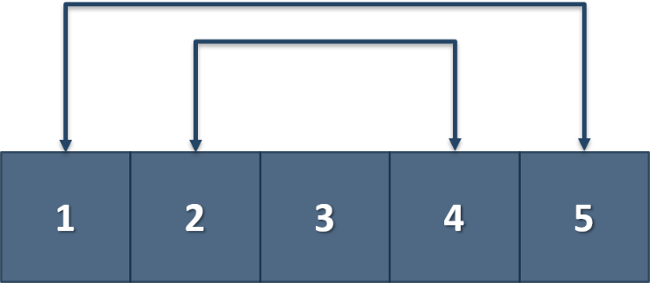
Problem: Gauss' Trick
Write a program that sums all numbers in a list in the
following order:
  first + last, first + 1 + last - 1, first + 2 + last - 2, … first + n, last – n
Examples:
1 2 3 4 5
6 6 3
1 2 3 4
5 5
Check your solution here: https://judge.softuni.bg/Contests/1210/Lists-Lab

Slide 17
Solution: Gauss' Trick
List<int> numbers = Console.ReadLine()
.Split().Select(int.Parse).ToList();
int originalLength = numbers.Count;
for (int i = 0; i < originalLength / 2; i++)
{
numbers[i] += numbers[numbers.Count - 1];
numbers.RemoveAt(numbers.Count - 1);
}
Console.WriteLine(string.Join(" ", numbers));
Check your solution here: https://judge.softuni.bg/Contests/1210/Lists-Lab

Slide 18

Problem: Merging Lists
You receive two lists with numbers. Print a result list, which
contains the numbers from both of the lists
  If the length of the two lists are not equal, just add the
  remaining elements at the end of the list:
  list1[0], list2[0], list1[1], list2[1], …
1 2 3 4 5
6 7 8
1 6 2 7 3 8 4 5
Check your solution here: https://judge.softuni.bg/Contests/1210/Lists-Lab

Slide 19
Solution: Merging Lists (1)
//TODO: Read the input
List<int> resultNums = new List<int>();
for (int i = 0; i < Math.Min(nums1.Count, nums2.Count); i++)
//TODO: Add numbers in resultNums
if (nums1.Count > nums2.Count)
resultNums.AddRange(GetRemainingElements(nums1, nums2));
else if (nums2.Count > nums1.Count)
resultNums.AddRange(GetRemainingElements(nums2, nums1));
Console.WriteLine(string.Join(" ", resultNums));
Check your solution here: https://judge.softuni.bg/Contests/1210/Lists-Lab

Slide 20
Solution: Merging Lists (2)
static List<int> GetRemainingElements(List<int> longerList, List<int> shorterList)
{
List<int> nums = new List<int>();
for (int i = shorterList.Count; i < longerList.Count; i++)
nums.Add(longerList[i]);
return nums;
}
Check your solution here: https://judge.softuni.bg/Contests/1210/Lists-Lab
Notes:
© SoftUni – https://softuni.org. Copyrighted document. Unauthorized copy or reproduction is not permitted.

Slide 21

Live Exercises
Reading and Manipulating Lists

Slide 22

Sorting Lists and Arrays

Slide 23
Sorting Lists
Sorting a list == reorder its elements incrementally: Sort()
  List items should be comparable, e.g. numbers, strings, dates, …
List<string> names = new List<string>()
{"Peter", "Michael", "George", "Victor", "John" };
names.Sort();
Console.WriteLine(string.Join(", ", names));
// George, John, Michael, Peter, Victor
names.Sort();
names.Reverse();
Console.WriteLine(string.Join(", ", names));
// Victor, Peter, Michael, John, George
Sort in natural (ascending) order
Reverse the sorted result

Slide 24
Problem: List of Products
Read a number n and n lines of products. Print a numbered list of all the products ordered by name.
Examples:
4
Potatoes
Tomatoes
Onions
Apples
AZ
1.Apples
2.Onions
3.Potatoes
4.Tomatoes

Slide 25
Solution: List of Products
int n = int.Parse(Console.ReadLine());
List<string> products = new List<string>();
for (int i = 0; i < n; i++)
{
string currentProduct = Console.ReadLine();
products.Add(currentProduct);
}
products.Sort();
for (int i = 0; i < products.Count; i++)
Console.WriteLine($"{i + 1}.{products[i]}");

Slide 26
Problem: Remove Negatives and Reverse
Read a list of integers, remove all negative numbers from it.
  Print the remaining elements in reversed order
  In case of no elements left in the list, print "empty"
10 -5 7 9 -33 50
50 9 7 10
7 -2 -10 1
1 7
-1 -2 -3
empty
Check your solution here: https://judge.softuni.bg/Contests/1210/Lists-Lab

Slide 27
Solution: Remove Negatives and Reverse
List<int> nums = // TODO: Read the List from the console.
for (int i = 0; i < nums.Count; i++)
if (nums[i] < 0) { nums.RemoveAt(i--); }
nums.Reverse();
if (nums.Count == 0)
Console.WriteLine("empty");
else
Console.WriteLine(string.Join(" ", nums));
Check your solution here: https://judge.softuni.bg/Contests/1210

Slide 28
Live Exercises
Sorting Lists

Slide 29

Summary
…
…
…
Lists hold a sequence of elements
(variable-length)
Can add / remove / insert elements
at runtime
Creating (allocating) a list: new List<T>()
Accessing list elements by index
Printing list elements: string.Join(…)
Notes:
© SoftUni – https://softuni.org. Copyrighted document. Unauthorized copy or reproduction is not permitted.

Slide 30

Notes:
© SoftUni – https://softuni.org. Copyrighted document. Unauthorized copy or reproduction is not permitted.

Slide 31
Trainings @ Software University (SoftUni)
Software University – High-Quality Education, Profession and Job for Software Developers
  softuni.bg, about.softuni.bg
Software University Foundation
  softuni.foundation
Software University @ Facebook
  facebook.com/SoftwareUniversity
Software University Forums
  forum.softuni.bg
Notes:
© SoftUni – https://softuni.org. Copyrighted document. Unauthorized copy or reproduction is not permitted.

Slide 32

License
This course (slides, examples, demos, exercises, homework, documents, videos and other assets) is copyrighted content
Unauthorized copy, reproduction or use is illegal
© SoftUni – https://about.softuni.bg/
© Software University – https://softuni.bg
Notes:
© SoftUni – https://softuni.org. Copyrighted document. Unauthorized copy or reproduction is not permitted.

